Slide 1



File system explorer using python
CSA0491 -Operating Systems for Process Scheduling
Project by,
L.Kalyani,M.Gowri sankar,M.Veera badru
(192224191,192210396,192210158)
Operating Systems
SSE,SIMATS
Guided By, Dr. G Mary Valantina
(Course Faculty) Operating Systems
SSE, SIMATS

Slide 2

ABSTRACT
The File System Explorer project aims to enhance the functionality of traditional file management systems by incorporating advanced features such as file compression, encryption, and permissions management. These additional capabilities are essential for modern file systems to ensure data security, integrity, and efficient utilization of storage resources.The incorporation of these advanced features in the File System Explorer project significantly enhances its utility and relevance in real-world file management scenarios. By enabling file compression, encryption, and permissions management, the extended File System Explorer ensures efficient storage utilization, protects sensitive data from unauthorized access, and maintains data integrity, thus addressing critical requirements for modern file systems in terms of security, performance, and resource management.
Keywords: File system explorer,File compression,Encryption,Permission management

Slide 3
INTRODUCTION
The File System Explorer project aims to elevate traditional file management capabilities by integrating advanced functionalities like file compression, encryption, and permissions management.
The basic file operations like navigation and manipulation, this project extends the functionality to include features crucial for modern data security and integrity.
The incorporation of file compression, encryption, and permissions management plays a pivotal role in enhancing data security and integrity within real-world file systems.
File encryption ensures that sensitive data remains protected from unauthorized access, mitigating the risk of data breaches and ensuring confidentiality in various scenarios.
The primary objective of the File System Explorer is with these advanced features, the project aims to booster data security measures and align with regulatory standards concerning data protection and privacy.

Slide 4
HARDWARE & SOFTWARE REQUIREMENTS
HARDWARE :
PROCESSOR : AMD Ryzen 7 5700U with Radeon Graphics 1.80 GHz, 64-bit operating system, x64-based processor
STORAGE : 512GB SSD
MEMORY : 8GB RAM
GRAPHIC CARD : IN-BUILT RADEON GRAPHICS
SOFTWARE :
OS : WINDOWS 10/11
PYTHON : 3.12.6
INTEGRATED DEVELOPMENT ENVIRONMENT (IDE) :
Visual Studio Code
PACKAGE :
Zip file library.
Cryptography using fernet.
Pip installation.

Slide 5
EXISTING SYSTEM
The current system lacks advanced security features like file compression, encryption, and permissions management, making it susceptible to unauthorized access and data breaches.
Users can perform simple file operations within the existing system, but there's a need for enhanced capabilities to handle large files efficiently and securely.
The current interface offers a straightforward user experience but lacks options for advanced file manipulation and protection.
Lack of file compression support results in inefficient storage utilization and slower data transfer speeds, especially when dealing with large volumes of files.

Slide 6
PROPOSED SYSTEM
The system will support file compression to optimize storage space and improve data transfer efficiency.
The system will be designed to be compatible across different operating systems, ensuring accessibility and usability for a wide range of users in real-world environments.
The suggested system will be scalable, effective, and able to manage massive file volumes with high security and integrity standards.
It protects sensitive information, reduces the risk of data breaches, and maintains data confidentiality, integrity, and availability.

Slide 7
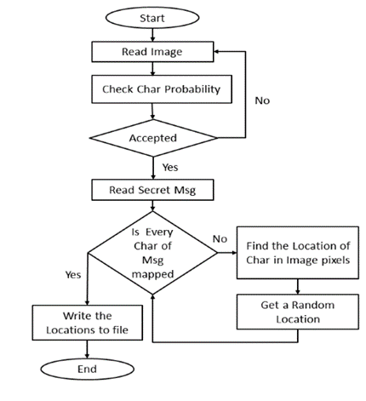
ARCHITECTURE

Slide 8
DESIGN

Slide 9
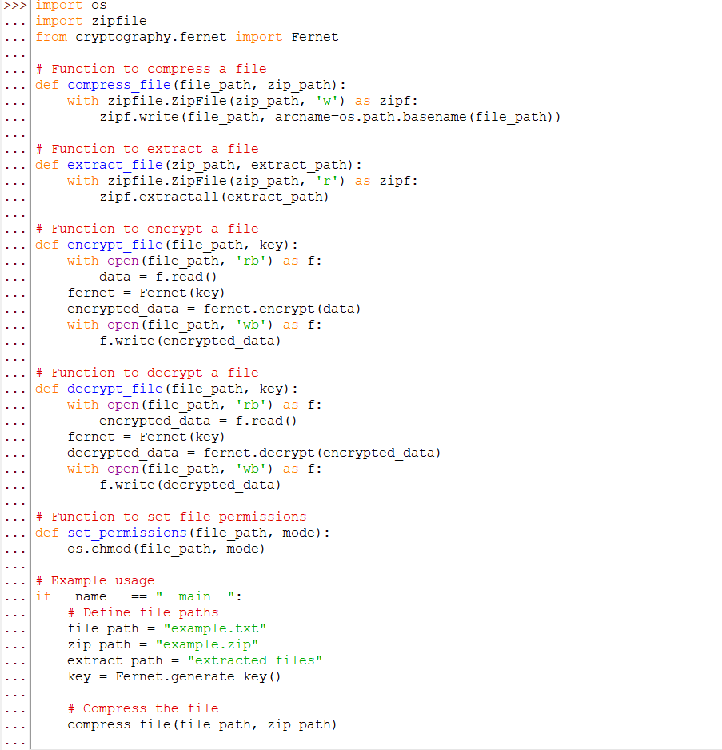
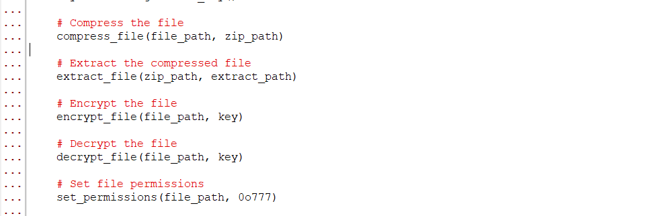
CODING

Slide 10
TESTING
Types of testing:
Functional Testing
Security testing
Performance testing
Regression testing
Testing tools:
Selenium for functional testing
Nessus for security testing
Apache jmeter for performance testing
JNet for Regression testing
Test cases and Results:
Test cases designed to cover various scenarios,from simple to complex web structures.
Results documented and analyzed for improvement

Slide 11
IMPLEMENTATION
Deployment Environment:
Compatible with Windows, macOS, and Linux environments.
Requires Python interpreter and relevant libraries.
Execution Process:
User input File and paths provided.
The creation of this zip file archive, extraction of files from the archive, encryption and decryption of files, and setting file permissions.
User Guidelines:
User-friendly interface with clear instructions.
Real time feed back during execution.

Slide 12
FINAL OUTPUT

Slide 13
CONCLUSION
In conclusion, the extension of the File System Explorer project with advanced features such as file compression, encryption, and permissions management significantly enhances data security and integrity in real-world file systems. By incorporating these features, users and organizations can better protect sensitive information, regulate access to files, and ensure data confidentiality during storage, transmission, and manipulation.This project not only addresses modern data security challenges but also empowers users with greater control over their digital assets, ultimately contributing to a more secure and trustworthy file management environment.

Slide 14
FUTURE SCOPE
Integration with cloud storage services for seamless file management.
Implementing AI-driven features for intelligent file organization.
Continuously updating encryption algorithms, permissions management.
Improving the user interface, accessibility features, and customization options for an enhanced user experience.

Slide 15
REFERENCE
WWW.Wikipedia.com
www.google.com
www.kaggle.com

Slide 16
THANK YOU
TEAM MEMBERS:
L.Kalyani,M.Gowri Shankar,M.veera badru
REGISTER NUMBER :
192224191,192210396,192210158

